Slide 1
Chapter 8: Confidence Intervals based on a Single Sample
http://pballew.blogspot.com/2011/03/100-confidence-interval.html

Slide 2
8.1: Point Estimation - Goals
Be able to differentiate between an estimator and an estimate.
Be able to define what is meant by a unbiased or biased estimator and state which is better in general.
Be able to determine from the pdf of a distribution, which estimator is better.
Be able to define MVUE (minimum-variance unbiased estimator).
Be able to state what estimator we will be using for the rest of the book and why we are using the estimator.

Slide 3
Definitions
A point estimate of a population parameter, θ, is a single number computed from a sample, which serves as a best guess for the parameter.
An estimator is a statistic of interest, and is therefore a random variable. An estimator has a distribution, a mean, a variance, and a standard deviation.
An estimate is a specific value of an estimator.

Slide 4
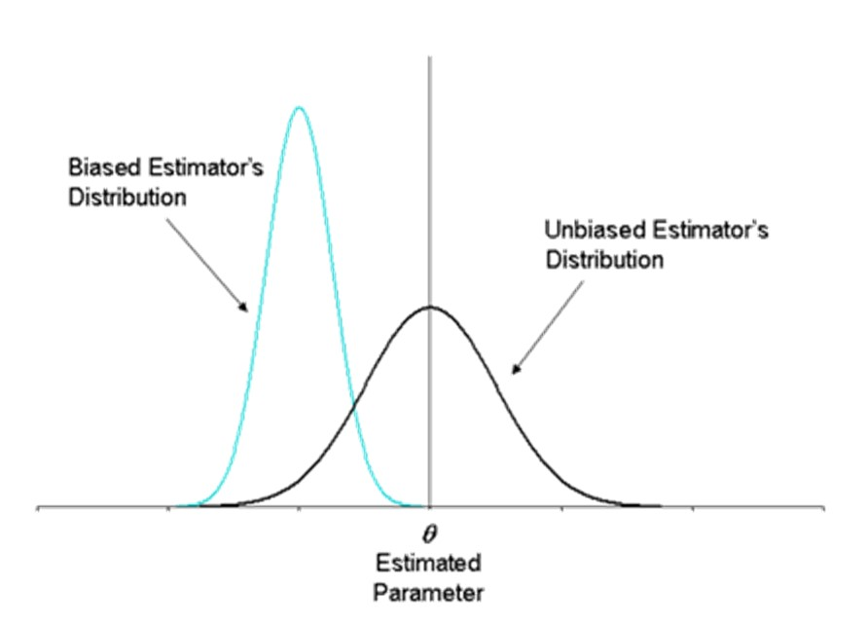
Biased/Unbiased Estimator
A statistic $\hat{θ}$ is an unbiased estimator of a population parameter θ if $E\left(\hat{θ}\right)=θ$.
If $E\left(\hat{θ}\right)≠θ$, the then statistic $\hat{θ}$ is a biased estimator.
http://www.weibull.com/DOEWeb/unbiased_and_biased_estimators.htm

Slide 5
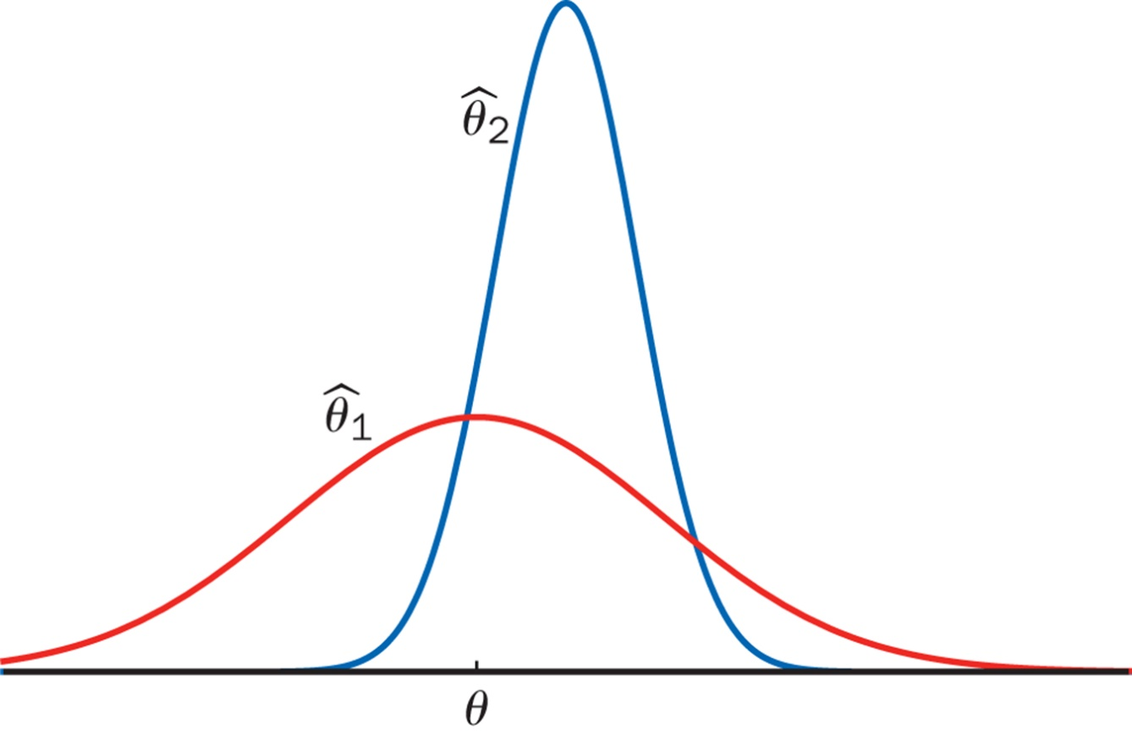
Estimators with Minimum Variance

Slide 6
8.2: A confidence interval (CI) for a population mean when σ is known- Goals
State the assumptions that are necessary for a confidence interval to be valid.
Be able to construct a confidence level C CI for μ for a sample size of n with known σ (critical value).
Explain how the width changes with confidence level, sample size and sample average.
Determine the sample size required to obtain a specified width and confidence level C.
Be able to construct a confidence level C confidence bound for μ for a sample size of n with known σ (critical value).
Determine when it is proper to use the CI.

Slide 7
Assumptions for Inference
We have an SRS from the population of interest.
The variable we measure has a Normal distribution (or approximately normal distribution) with mean μ and standard deviation σ.
We don’t know μ
but we do know σ (Section 8.2)
We do not know σ (Section 8.3)
σ

Slide 8
Definition of CI
A confidence interval (CI) for a population parameter is an interval of values constructed so that, with a specified degree of confidence, the value of the population parameter lies in this interval.
The confidence coefficient, C, is the probability the CI encloses the population parameter in repeated samplings.
The confidence level is the confidence coefficient expressed as a percentage.

Slide 9
z_{α/2}
z_{α/2} is a value on the measurement axis in a standard normal distribution such that
P(Z ≥ z_{α/2}) = α/2.
P(Z ≤ -z_{α/2}) = α/2
P(Z ≤ z_{α/2}) = 1- α/2

Slide 10
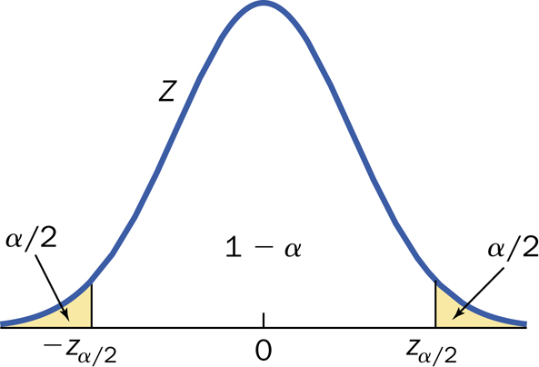
Confidence Interval: Definition

Slide 11
Confidence Interval
$$\left(\overline{x}−z_{α/2}\frac{σ}{\sqrt{n}},\overline{x}+z_{α/2}\frac{σ}{\sqrt{n}}\right)$$
$$\overline{x}±z_{α/2}\frac{σ}{\sqrt{n}}$$
ME $=z_{α/2}\frac{σ}{\sqrt{n}}$

Slide 12
Interpretation of CI
The population parameter, µ, is fixed.
The confidence interval varies from sample to sample.
It is correct to say “We are 95% confident that the interval captures the true mean µ.”
It is incorrect to say “We are 95% confident µ lies in the interval.”
In repeated samples, the proportion of confidence intervals that capture the true value of µ approaches the confidence coefficient.

Slide 13
CI conclusion
We are 95% (C%) confident that the population (true) mean of […] falls in the interval (a,b) [or is between a and b].
We are 95% confident that the population (true) mean yield of this type of corn falls in the interval (121.4, 126.2) [or is between 121.4 and 126.2 bushels].

Slide 14
Table III (end of table)

Slide 15
How Confidence Intervals Behave
We would like high confidence and a small margin of error
$ME=z_{α/2}\frac{σ}{\sqrt{n}}$
lower C
reduce σ
increase n
C | z_{α/2} | CI
0.90 | 1.6449 | (2.041, 2.495)
0.95 | 1.96 | (1.997, 2.539)
0.99 | 2.5758 | (1.912. 2.624)

Slide 16
Practical Procedure
Plan your experiment to obtain the lowest σ possible.
Determine the confidence level that you want.
Determine the largest possible width that is acceptable.
Calculate what n is required.
Perform the experiment.

Slide 17

Summary CI
Confidence Interval $\overline{x}±z_{α/2}\frac{σ}{\sqrt{n}}$
Upper Confidence Bound $μ<\overline{x}+z_{α}\frac{σ}{\sqrt{n}}$
Lower Confidence Bound $μ>\overline{x}−z_{α}\frac{σ}{\sqrt{n}}$
Confidence Level | 95% | 99%
Two – sided z critical value | 1.96 | 2.5758
One-sided z critical value | 1.6449 | 2.3263

Slide 18
Cautions
The data must be an SRS from the population.
Be careful about outliers.
You need to know the sample size.
You are assuming that you know σ.
The margin of error covers only random sampling errors!

Slide 19
8.3: Inference for the Mean of a Population - Goals
Be able to construct a level C confidence interval (without knowing σ) and interpret the results.
Be able to determine when the t procedure is valid.

Slide 20
Assumptions for Inference
We have an SRS from the population of interest.
The variable we measure has a Normal distribution (or approximately normal distribution) with mean μ and standard deviation σ.
We don’t know μ
but we do know σ (Section 8.2)
We do not know σ (Section 8.3)
σ

Slide 21
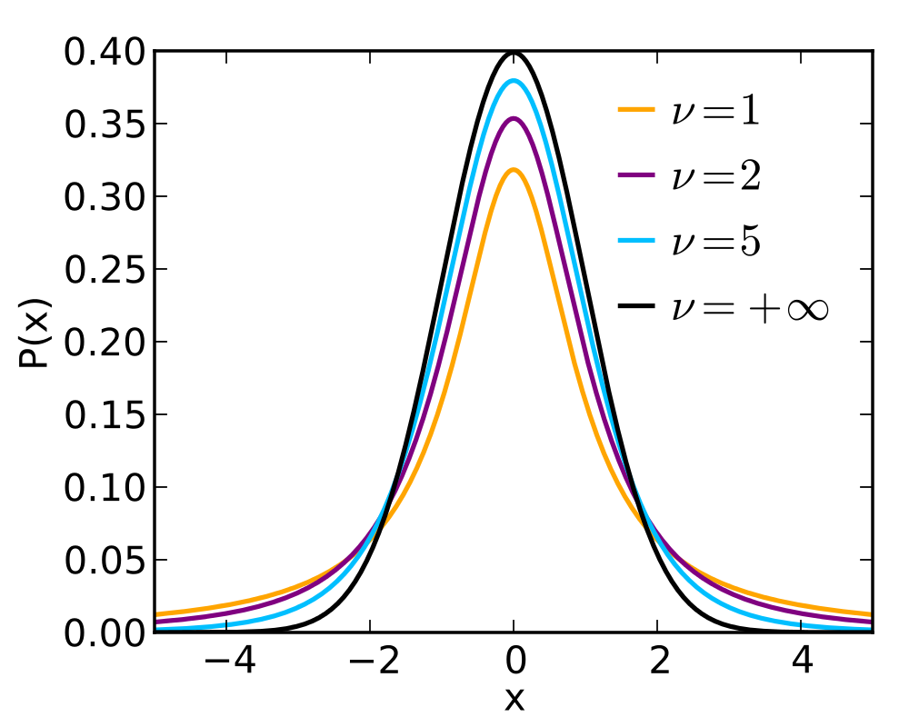
Shape of t-distribution
http://upload.wikimedia.org/wikipedia/commons/thumb/4/41/Student_t_pdf.svg/1000px-Student_t_pdf.svg.png

Slide 22
Table III vs. Table V
Table III | Table V
Standard normal (z) | t-distribution
P(Z ≤ z) | P(T > t*)
df not required | df required
Require: z_{α} Answer: probability | Require: probability Answer: t_{α}

Slide 23
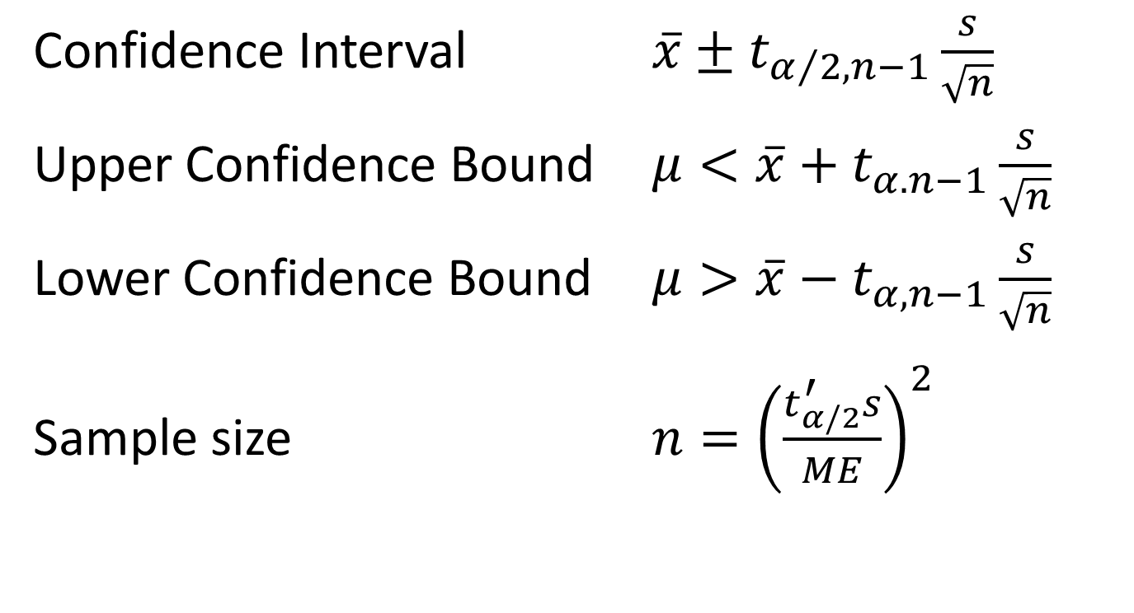
Summary CI – t distribution
Confidence Interval $\overline{x}±t_{α/{2,n−1}}\frac{s}{\sqrt{n}}$
Upper Confidence Bound $μ<\overline{x}+t_{α.n−1}\frac{s}{\sqrt{n}}$
Lower Confidence Bound $μ>\overline{x}−t_{α,n−1}\frac{s}{\sqrt{n}}$
Sample size $n={\left(\frac{t_{α/2}^{′}s}{ME}\right)}^{2}$

Slide 24
Robustness of the t-procedure
A statistical value or procedure is robust if the calculations required are insensitive to violations of the condition.
The t-procedure is robust against normality.
n < 15 : population distribution should be close to normal.
15 < n < 40: mild skewedness is acceptable
n > 40: procedure is usually valid.

